Slide 1

Superintendent Search

Slide 2
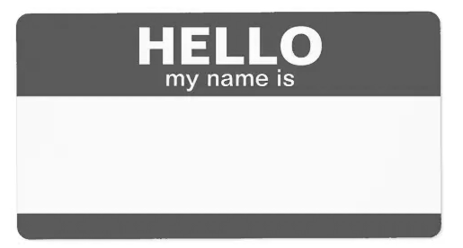

Rhonda Crass

Slide 3
PURPOSE
The District is committed to making this superintendent search a thorough and transparent one. Input will be gathered through the following:
Survey
Community Meeting
Faculty and Staff Meetings

Slide 4
Board’s Role
ESSENTIAL FUNCTIONS
Hire the Superintendent – This is probably the most important function the Board must exercise.
Set Board Policies and Procedures – The District’s Board policies and procedures are essential for effective District operations.
Set the Tax Rate – This is an essential function of the Board and should be done only after consultation with your Superintendent and CFO.
Adopt an annual budget – This essential function is performed in concert with the Superintendent and CFO.

Slide 5
Board’s Role
APPLICANTS
Only Board Members are allowed to know the name of the actual applicants for the position of Superintendent at Bastrop ISD.
Revealing the name of any applicant is a violation of the Texas Public Information Act.

Slide 6
Board’s Role
CONFIDENTIAL SEARCH
Encourages applicants to apply as it will not affect their current position in their current community.
It is not a good idea for an applicant to have a community member reach out to members of the Board.

Slide 7
Board’s Role
CONFIDENTIAL SEARCH
If you know someone who has applied and want to give them a good recommendation, contact me directly with the information.
Conversely, if you know someone who has applied and you don’t believe they are a good fit, contact me.

Slide 8
Questions
#1
What scares you the most about getting a new Superintendent?

Slide 9
Questions
#2
What do you consider to be the strengths of Bastrop ISD?

Slide 10
Questions
#3
What concerns do you have for Bastrop ISD?

Slide 11
Questions
#4
What do you think will be the most important issue for the new superintendent to address?

Slide 12
Questions
#5
What do you think is the most urgent issue that the new Superintendent must address?

Slide 13
Questions
#6
What are the most important personal qualities or characteristics you feel are needed for the next superintendent of Bastrop ISD?

Slide 14
Questions
#7
What do you think are the most professional qualities, important skills or education that are needed for the next superintendent of Bastrop ISD?

Slide 15
Questions
#8
What priorities will the new superintendent of Bastrop ISD need to address in the first 100 days of service?

Slide 16
The Process
Board’s Role
Board will take information and develop a profile for the attributes of the next Superintendent.
Board will post the position in October.
Board will determine what candidates to interview in late October or early November
Board will interview candidates in November. I will not attend the interviews.
After interviews, Board will determine who the lone finalist will be and will announce it in open session with a vote on the record.

Slide 17
NAMING A LONE FINALIST
Board’s Role
At the meeting where the Board names the lone finalist, the Board will make known to the public who the expected choice is for the position. They will announce it by taking a vote in open session. They may not hire the superintendent until at least 21 days after the Board has named a lone finalist.

Slide 18
NAMING A LONE FINALIST
Board’s Role
After the Board selects its lone finalist, the name of that individual must be posted which will be by taking a vote in open session for 21 days.
During the 21-day period, the Board will negotiate the contract with the new superintendent.

Slide 19
Contact Information:
Rhonda Crass
rhonda@leasorcrass.com
682-422-0009

